Slide 1




CITAP
Eagles
University of Washington MSIS
Prathik Pittala, Nikita kumari, Jung-Yu Shen
EAGLES
Notes:
Good morning, everyone. We are Team Eagles from the University of Washington, and this is our project: iCare — Scalable Vision for All.
We’re here to present a solution that brings accessible, AI-powered vision care to underserved populations.

Slide 2
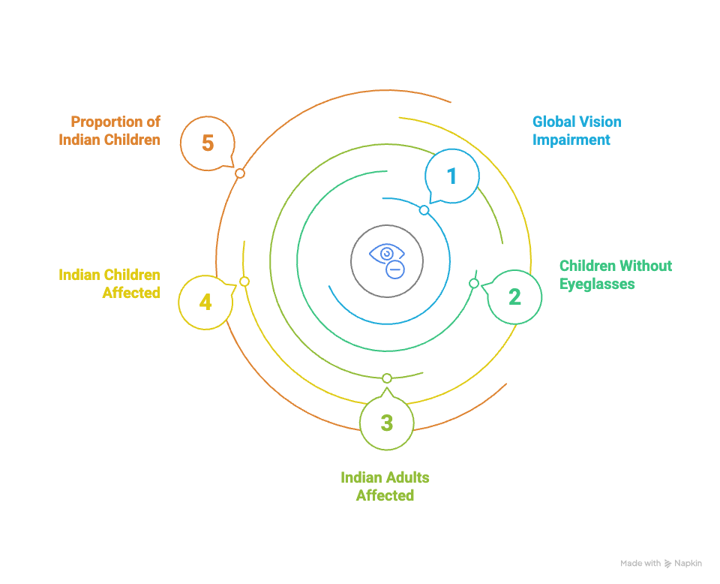
CITAP
EAGLES
Notes:
Defending Our Architecture Choices
Microservices: Faster scaling, localized failure resilience, service-specific scaling (critical for regional expansions).
Event-Driven: Offline-first workflows, asynchronous sync for rural low-connectivity scenarios.
Mobile-First + Edge AI: Vision tests and analysis work even without stable internet.
Privacy by Design: User ownership of data, 7-day image TTL, compliant by default with global health data standards.
Result: A platform that can operate at 100M users, even across rural India, without breaking.

Slide 3
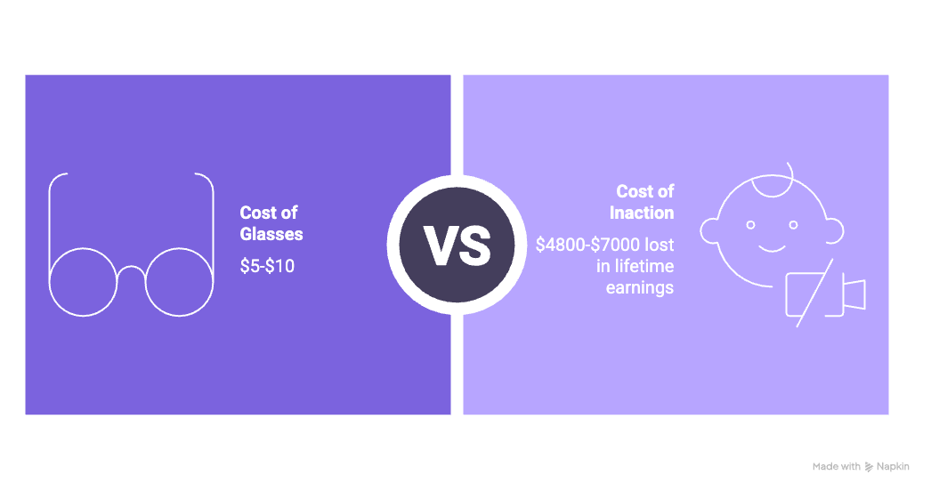
CITAP
Economic Impact
WHO estimates $411 billion loss globally due to productivity.
India loses $2 billion due to reduced schooling outcomes.
EAGLES
Notes:
Defending Our Architecture Choices
Microservices: Faster scaling, localized failure resilience, service-specific scaling (critical for regional expansions).
Event-Driven: Offline-first workflows, asynchronous sync for rural low-connectivity scenarios.
Mobile-First + Edge AI: Vision tests and analysis work even without stable internet.
Privacy by Design: User ownership of data, 7-day image TTL, compliant by default with global health data standards.
Result: A platform that can operate at 100M users, even across rural India, without breaking.

Slide 4
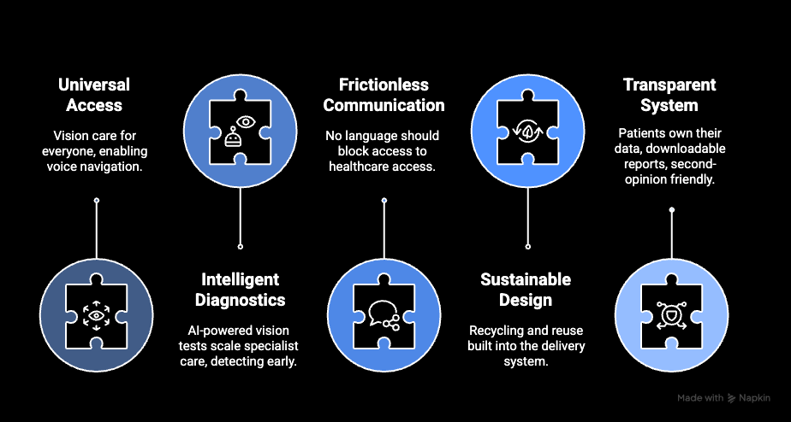
FIVE-PILLAR APPROACH
CITAP
EAGLES

Slide 5
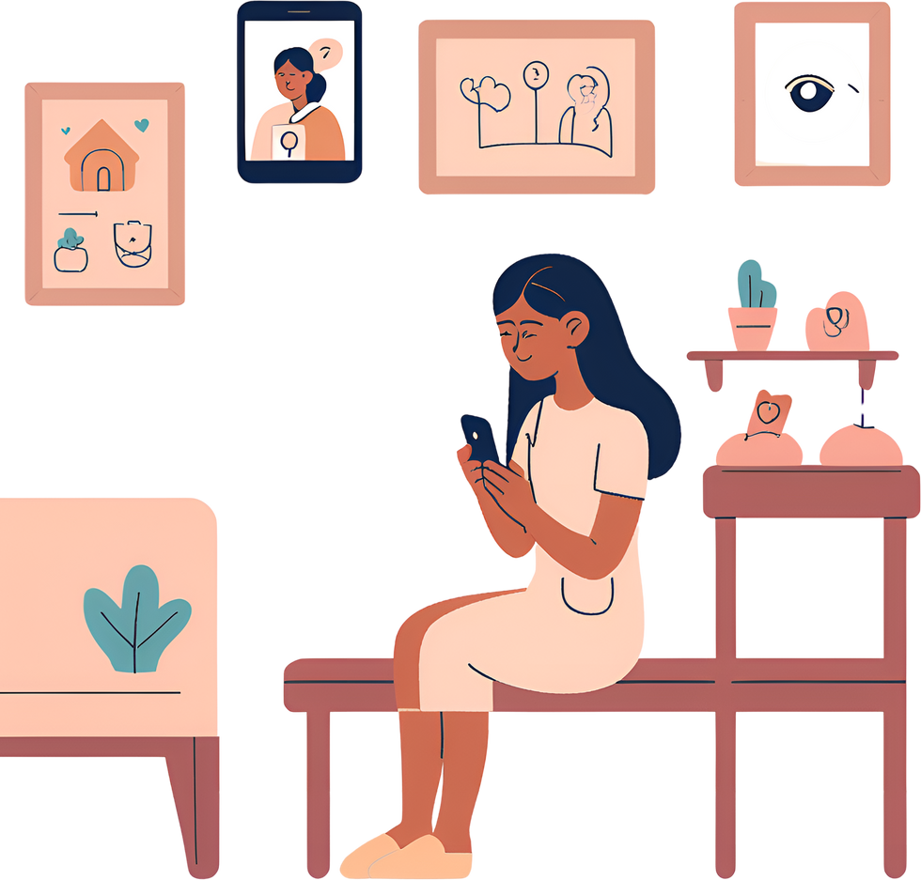

CITAP
Solution Demo
EAGLES
Notes:
Open Mobile App: Language selection, instant accessibility.
Self-Test Vision: Landolt-C, Ishihara, astigmatism tests via front camera.
AI Risk Assessment: Immediate results with actionable next steps.
Book Appointments / Order Glasses: Direct booking and subsidized ordering.
Monitor Vision History: Track improvements and future risks.

Slide 6


Slide 7
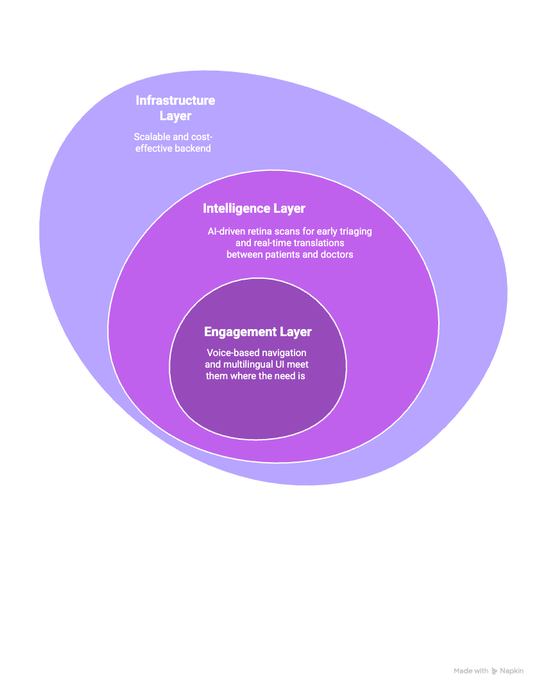
CITAP
Building Only
What Delivers
The Most Impact
EAGLES

Slide 8
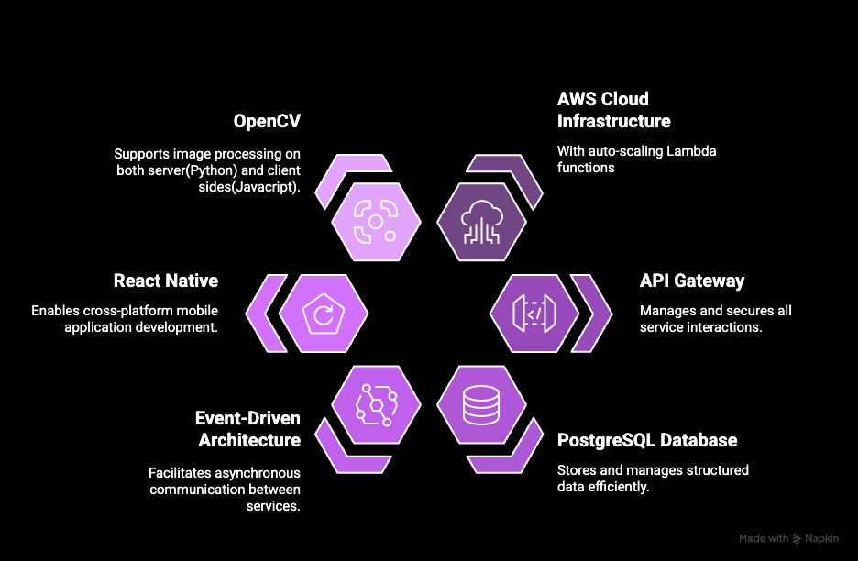
Technology Choices
CITAP
CITAP
EAGLES
Notes:
We chose React Native for cross-platform mobile, OpenCV for edge vision processing, and PostgreSQL for structured health data.
AWS Lambda keeps compute costs low while scaling, and Hugging Face APIs enable fast ML deployment.
Every choice was made for speed, scale, and accessibility.

Slide 9
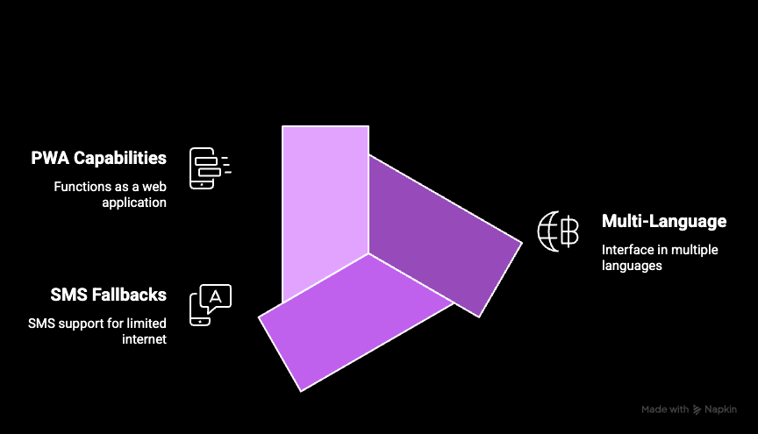
For Indian Realities
CITAP
EAGLES

Slide 10

CITAP
Build | Borrow | Buy
Offline-first mobile UI | TensorFlow for AI | Google Translation API
Vision test flow | OpenMRS for health records | Cloud messaging (e.g. Firebase)
WHY WE CAN SCALE WITHOUT BREAKING?
SCRUM Agile → Fast iteration, small releases
Modular Microservices → Deploy per region
Open-Source + Cloud Credits → $0 infra, maximum flexibility
Privacy-first, trust-centered product ethics
EAGLES

Slide 11
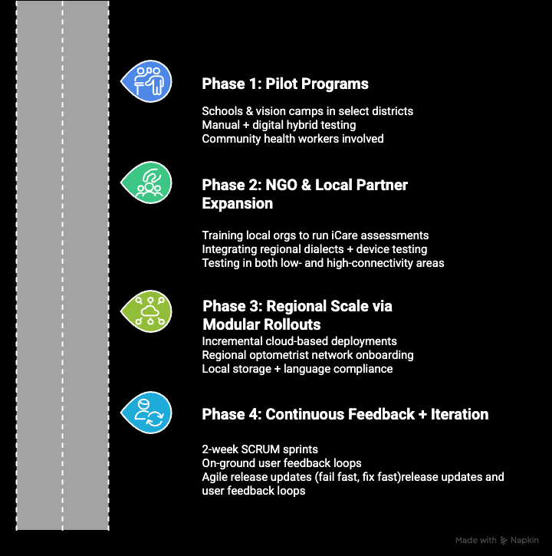
CITAP
EAGLES

Slide 12
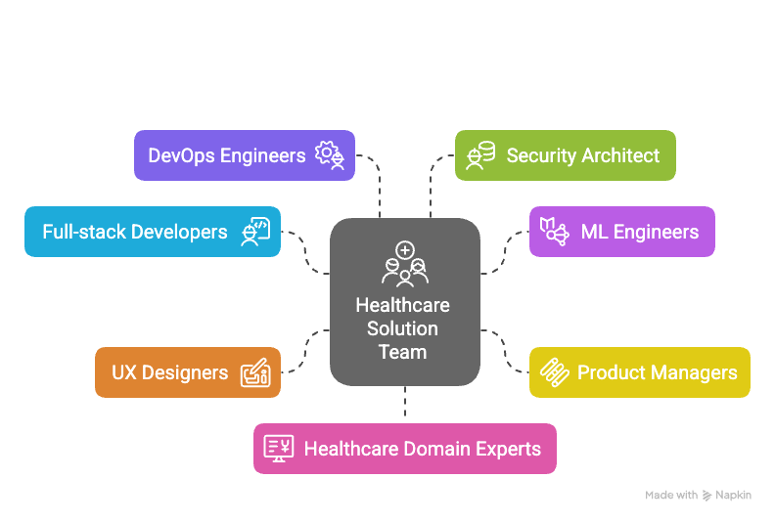
MVP launched fast by focusing on core features: self-test, risk score, booking
CITAP
Biweekly releases through SCRUM sprints
EAGLES

Slide 13
CITAP
TRUSTED NONPROFIT
TECH STACK
Security by Default.
Privacy by Design.
Tool | Use Case
Okta | Identity & access control
Box | Secure document storage
AWS | Cloud infrastructure + monitoring
Zoho One | Admin ops & analytics
Slack | Secure internal comms
Webex | Team & partner coordination
End-to-End Encryption — at rest and in transit
Role-Based Access Control — powered by Okta
Full Audit Trails — system-wide activity logging
Real-Time Monitoring — via AWS GuardDuty + CloudWatch
Zero-Trust Architecture — services are containerized and isolated
GDPR & CCPA-Conscious — regional compliance awareness
User Data Ownership — patients control their health records
EAGLES

Slide 14
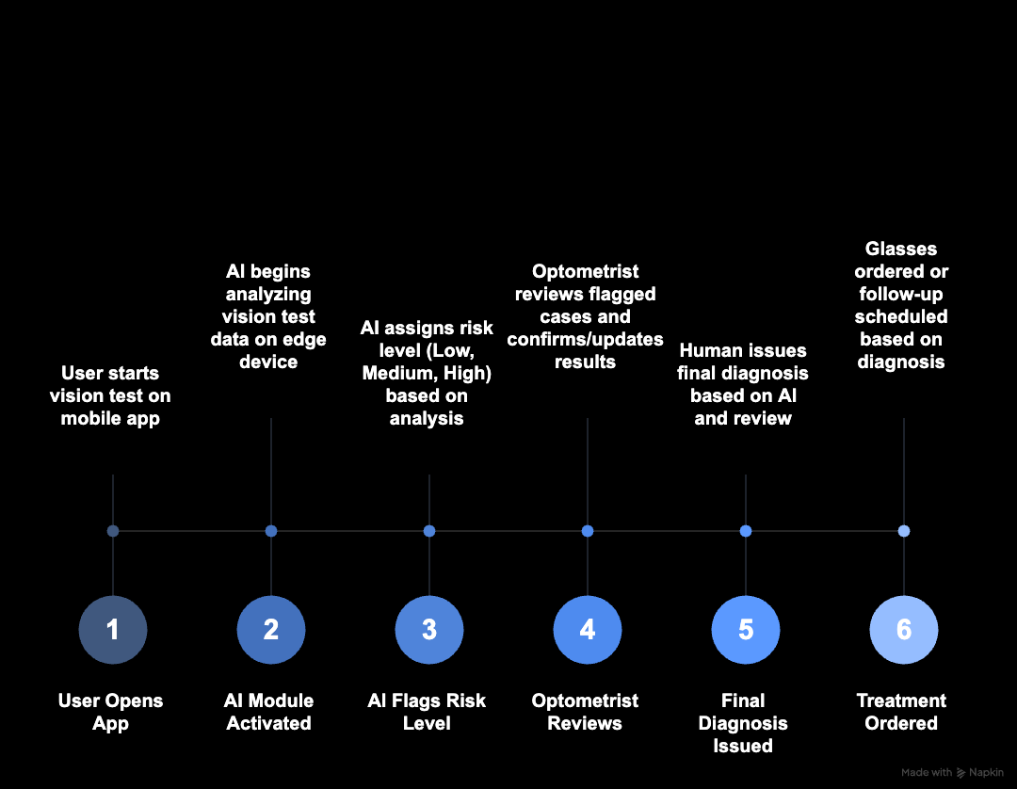
AI SPEEDS UP ACCESS. HUMANS SAFEGUARD TRUST.
CITAP
EAGLES

Slide 15
CITAP
Any Questions?
Let’s Explore Together.
EAGLES

